Slide 1
bettr.
Bettr. Stronger. Power.
Notes:
Problema: mancanza di comunicazione tra cittadino-comune/ente
Obbiettivo: identificare e risolvere qualsiasi tipo di problema attraverso la partecipazione dei cittadini
I cittadini posso dichiarare diversi problemi tramite un’interfaccia su un’applicazione
Tramite l’app gli utenti possono inoltre votare le varie issue che vengono ordinati in base alla loro priorità creando un ranking
Il servizio (dalla parte del comune/ente) riceve i dati e gli elabora

Slide 2
1.
The Problem

Slide 3
Every second person is a city resident in the world we live. According to UN predictions, over 67% of the population will be concentrated in the cities by the year 2050.

Slide 4

Modern cities
The latest technologies permit to collect, manage and process data in real time improving the quality and speed of decision.
Data is a major content feed-ing Data-driven city system and, at large, their volume, quality and diversity impact quality of decisions made based on them.

Slide 5
City Data
Open-data is instrumental for the improvement of smart-cities.
The large majority of this data can be generated by users.
Ironically enough, open-data platforms that serve this purpose are still largely nonexistent.

Slide 6
Component of DDC
Communications
and
interactions
Data
Technologies
and
infrastructure
DDC
Effect from implementation of solutions based on data

Slide 7
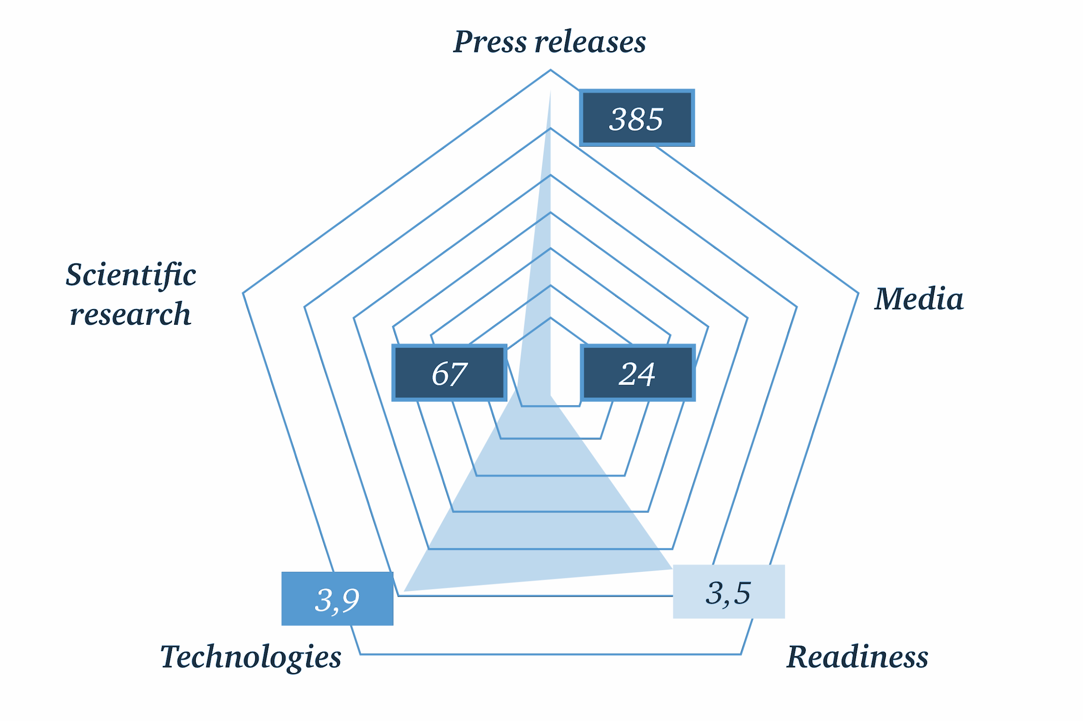
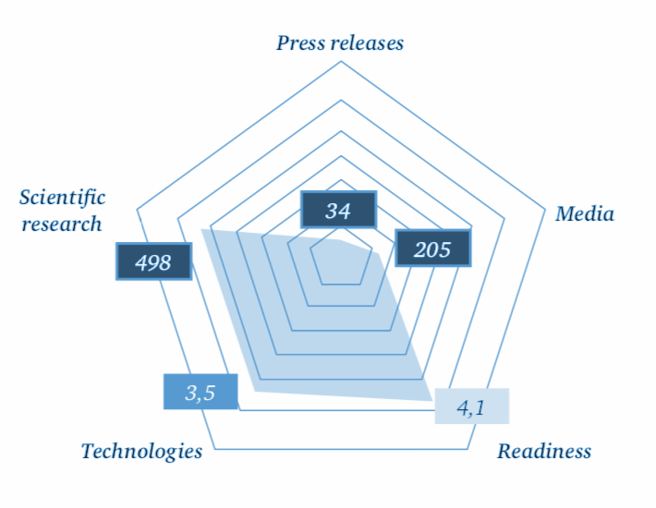
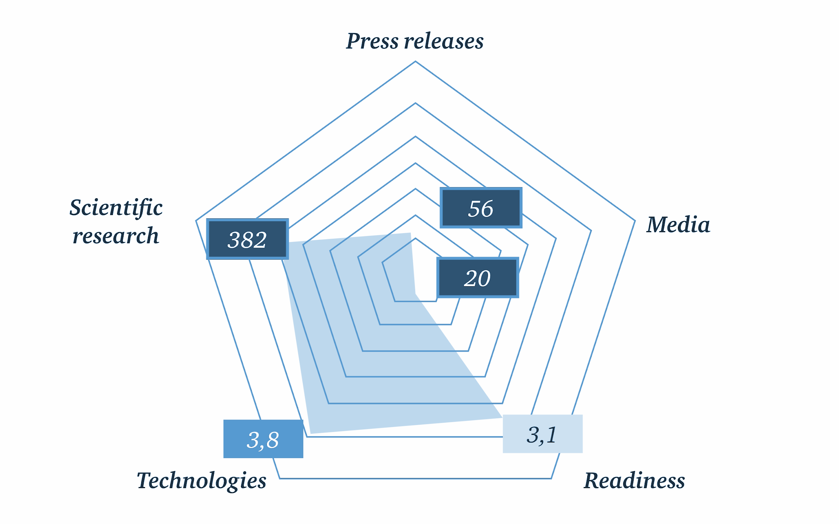
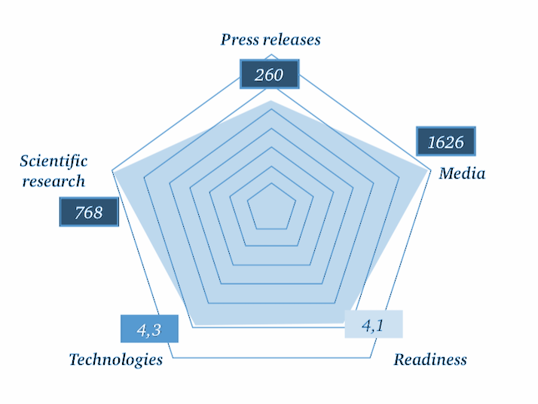
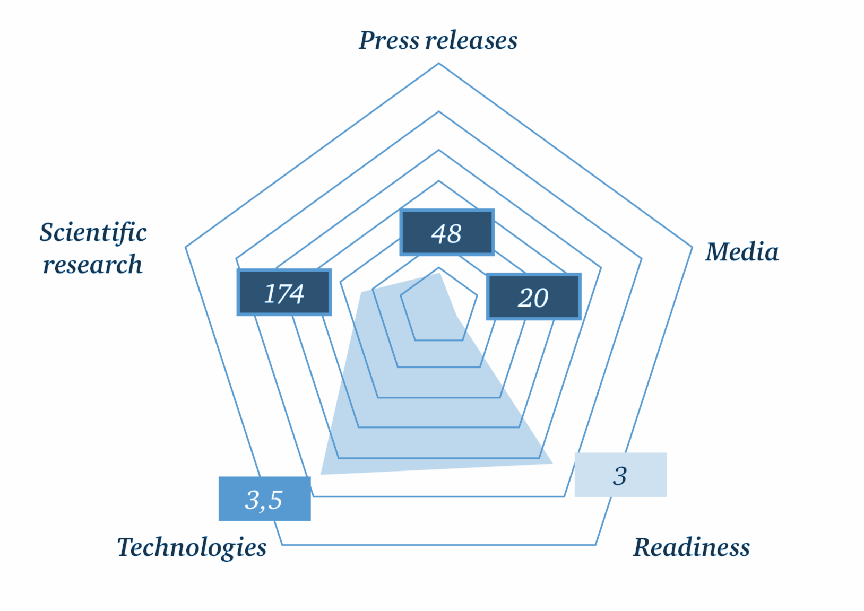

Comparative analysis of cities
Moscow
London
Barcelona
New York
Sydney
Source

Slide 8
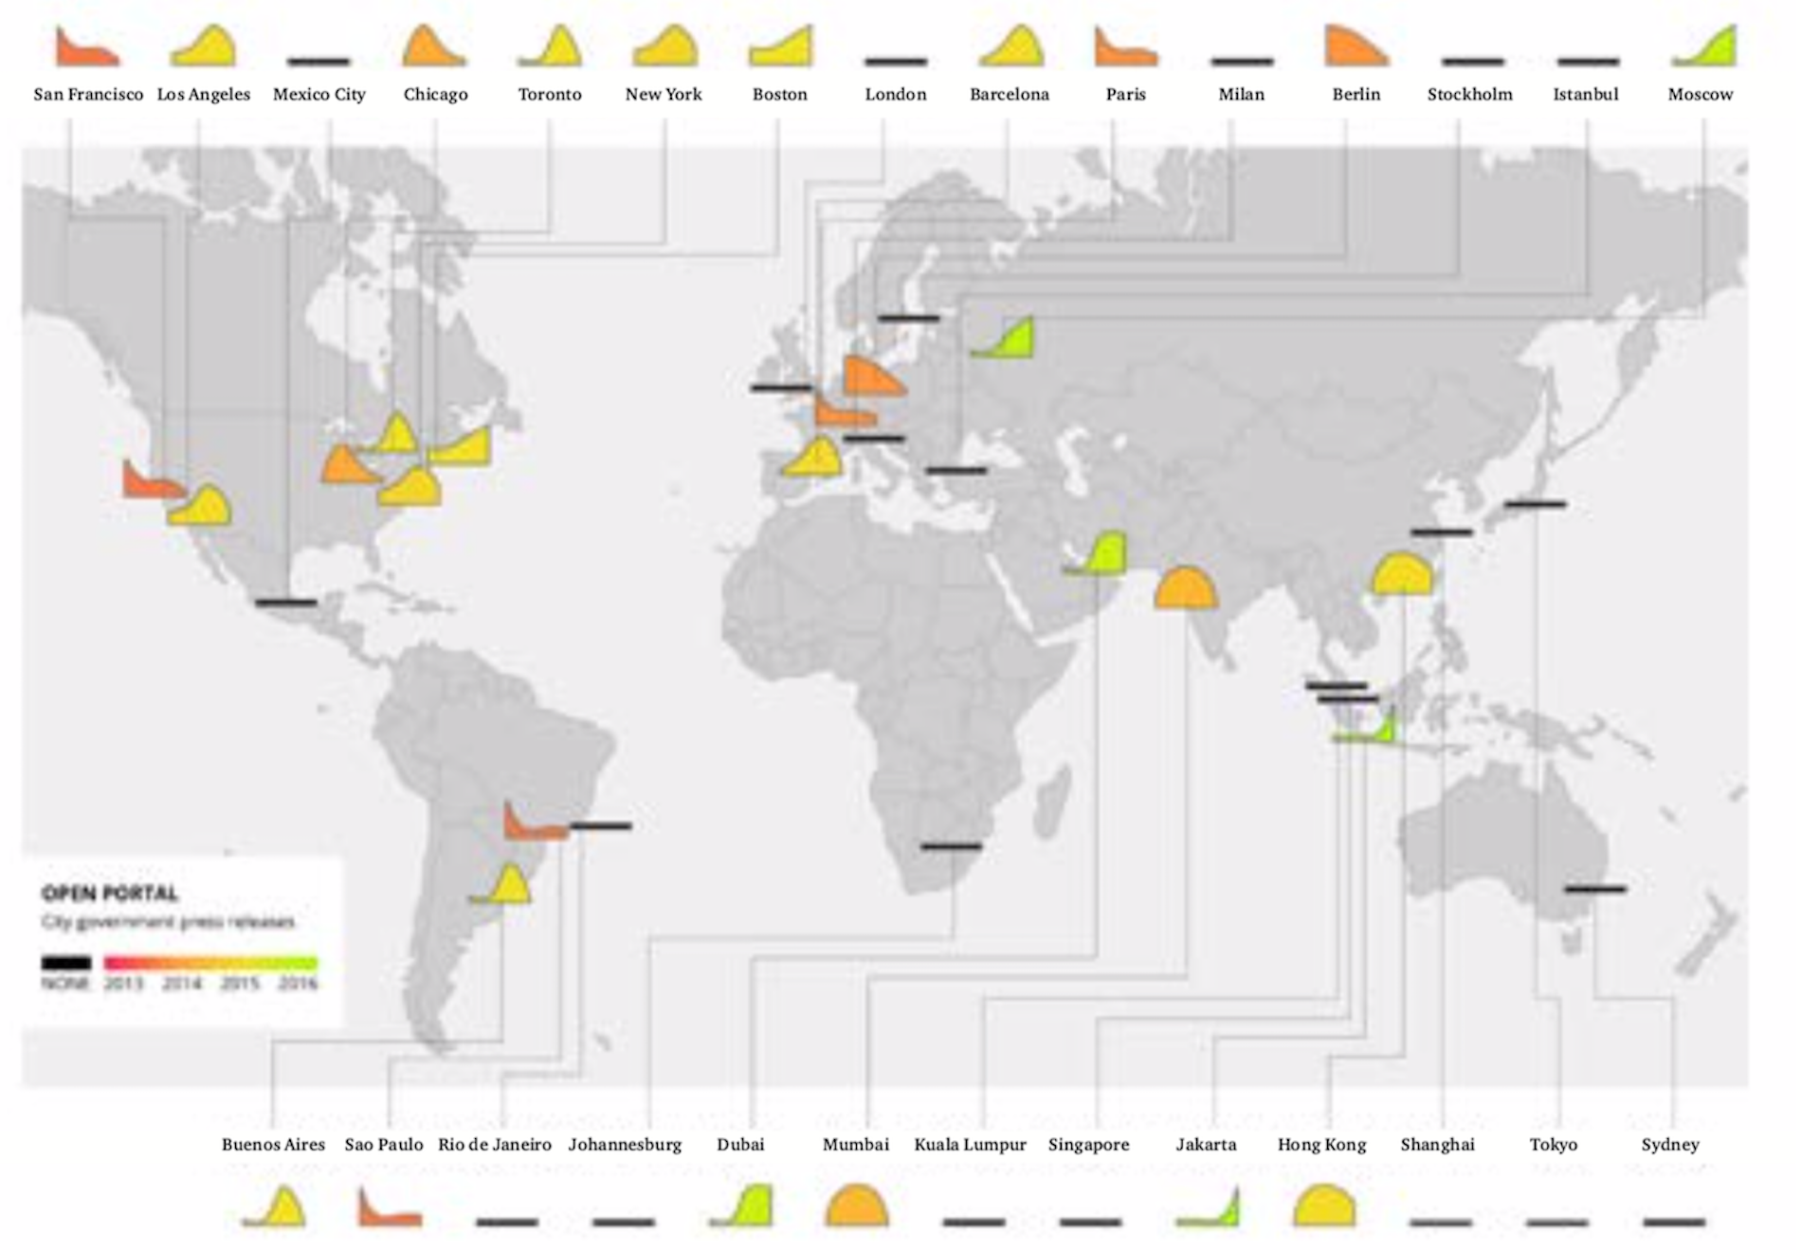
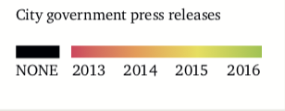
Open Portal
Source:

Slide 9
2.
Our solution

Slide 10
Background
Addressing the inevitable and never-ending societal changes is becoming ever more of a challenge.
It’s even more so when you’re faced with the availability of little to no data whatsoever.
Sparkling communities would love to contribute to the betterment of their cities, but they’re pretty much unable to.
An open-data platform for both communities and administrations would just fit the bill.
Coupling the massive amount of big-data raked in daily by sensors with the invaluable power of free constructive speech and opinion sharing would greatly benefit smart-cities (or smart-cities-to-be).
This is an evident circumstance of demand not being directly matched by an equal offer.

Slide 11
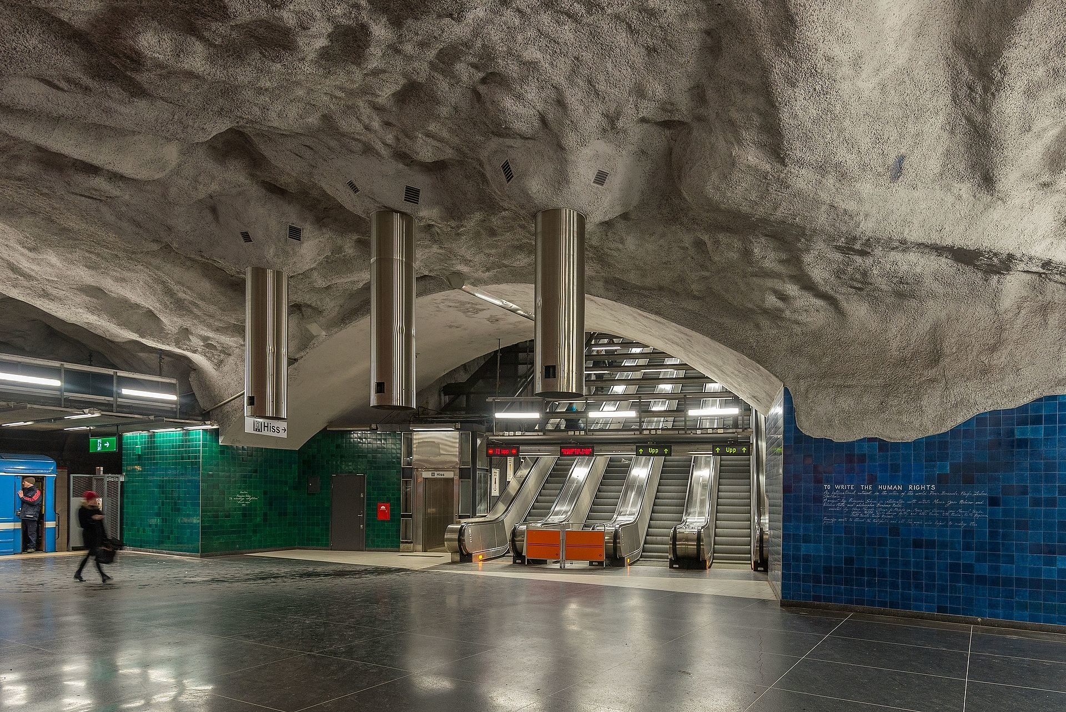
bettr.
The smart open data platform for big-data driven cities
“Bettr.” is an open-data platform where community users can post issues and share opinions for the betterment of big-data driven cities.
Universitetet Station, Stockholm - Arild Vågen
Notes:
Manca strumento di comunicazione tra città e cittadino, smart perchè la città sfrutta le piattaforma cloud etc per migliorare e fornre servizi migliori.
Innovariva in quanto non esiste realmente una piattaforma in cui io possa veramente segnalare il problema
Beneficio i comuni fino ad ora non hanno avuto strumenti come il loro lavoro sia per i cittadini
Il comune ha a disposizione una quantità elevata di dati che la macchina categorizza e ordina per semplificare il lavoro delle amministrazione

Slide 12
OUR PROCESS IS EASY
Post an issue or suggestion
Wait for your post to gain momentum
Wait for things to get better

Slide 13
3.
The nitty-gritty

Slide 14
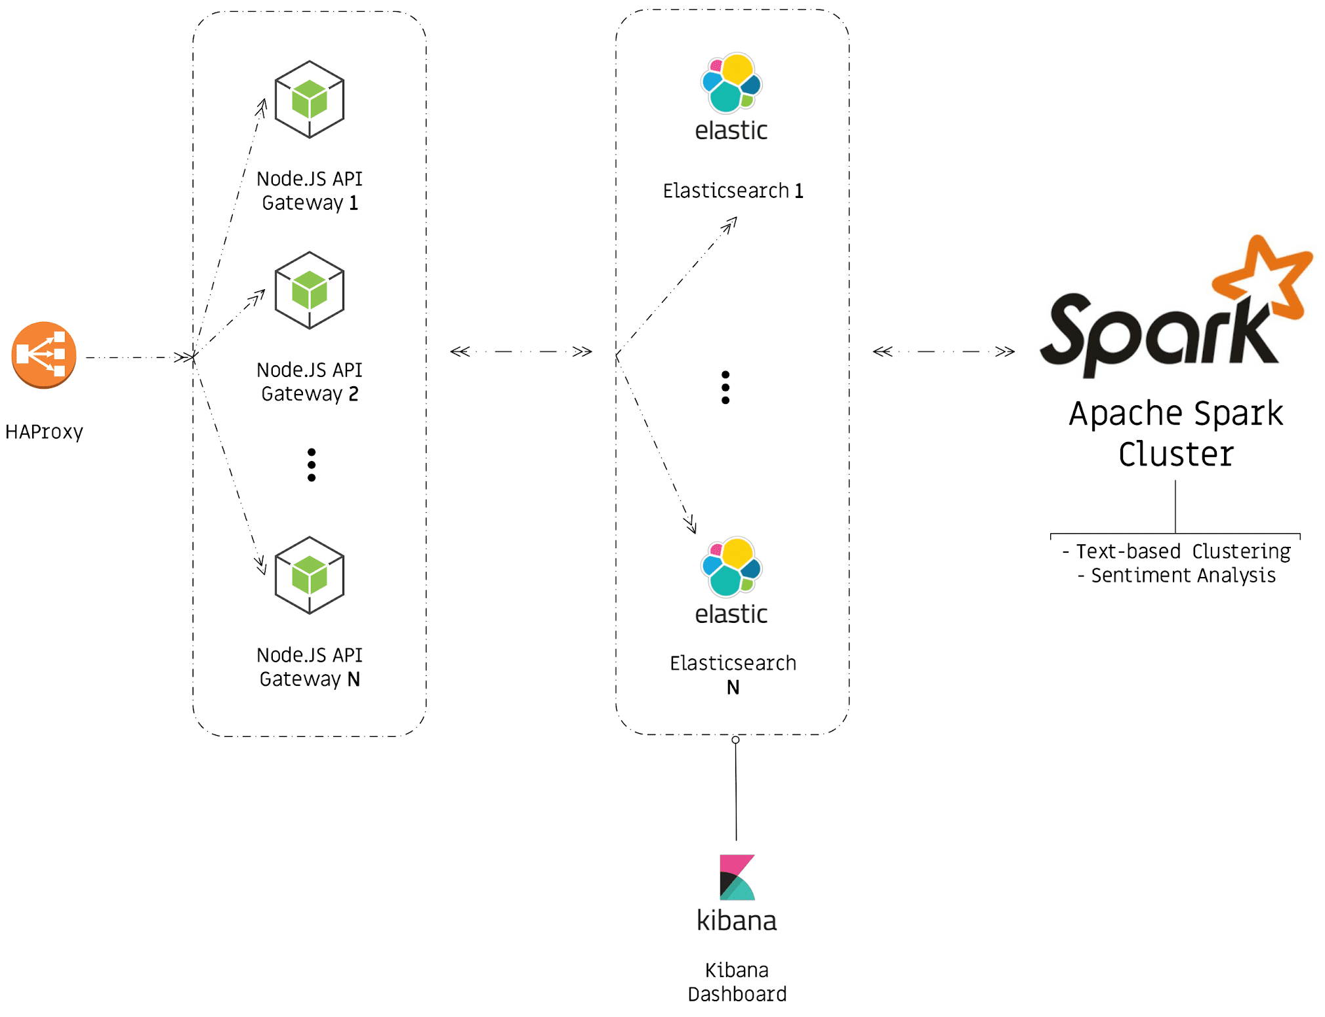

Slide 15


Modularity in Mind
+
Microservice Framework
Hapi.js Web Framework

Slide 16



Artificial Intelligence
+
+
Text-based Clustering
Sentiment Analysis

Slide 17
We start in Milan
Milan

Slide 18
~1,000,000
Potential users in Milan area

Slide 19
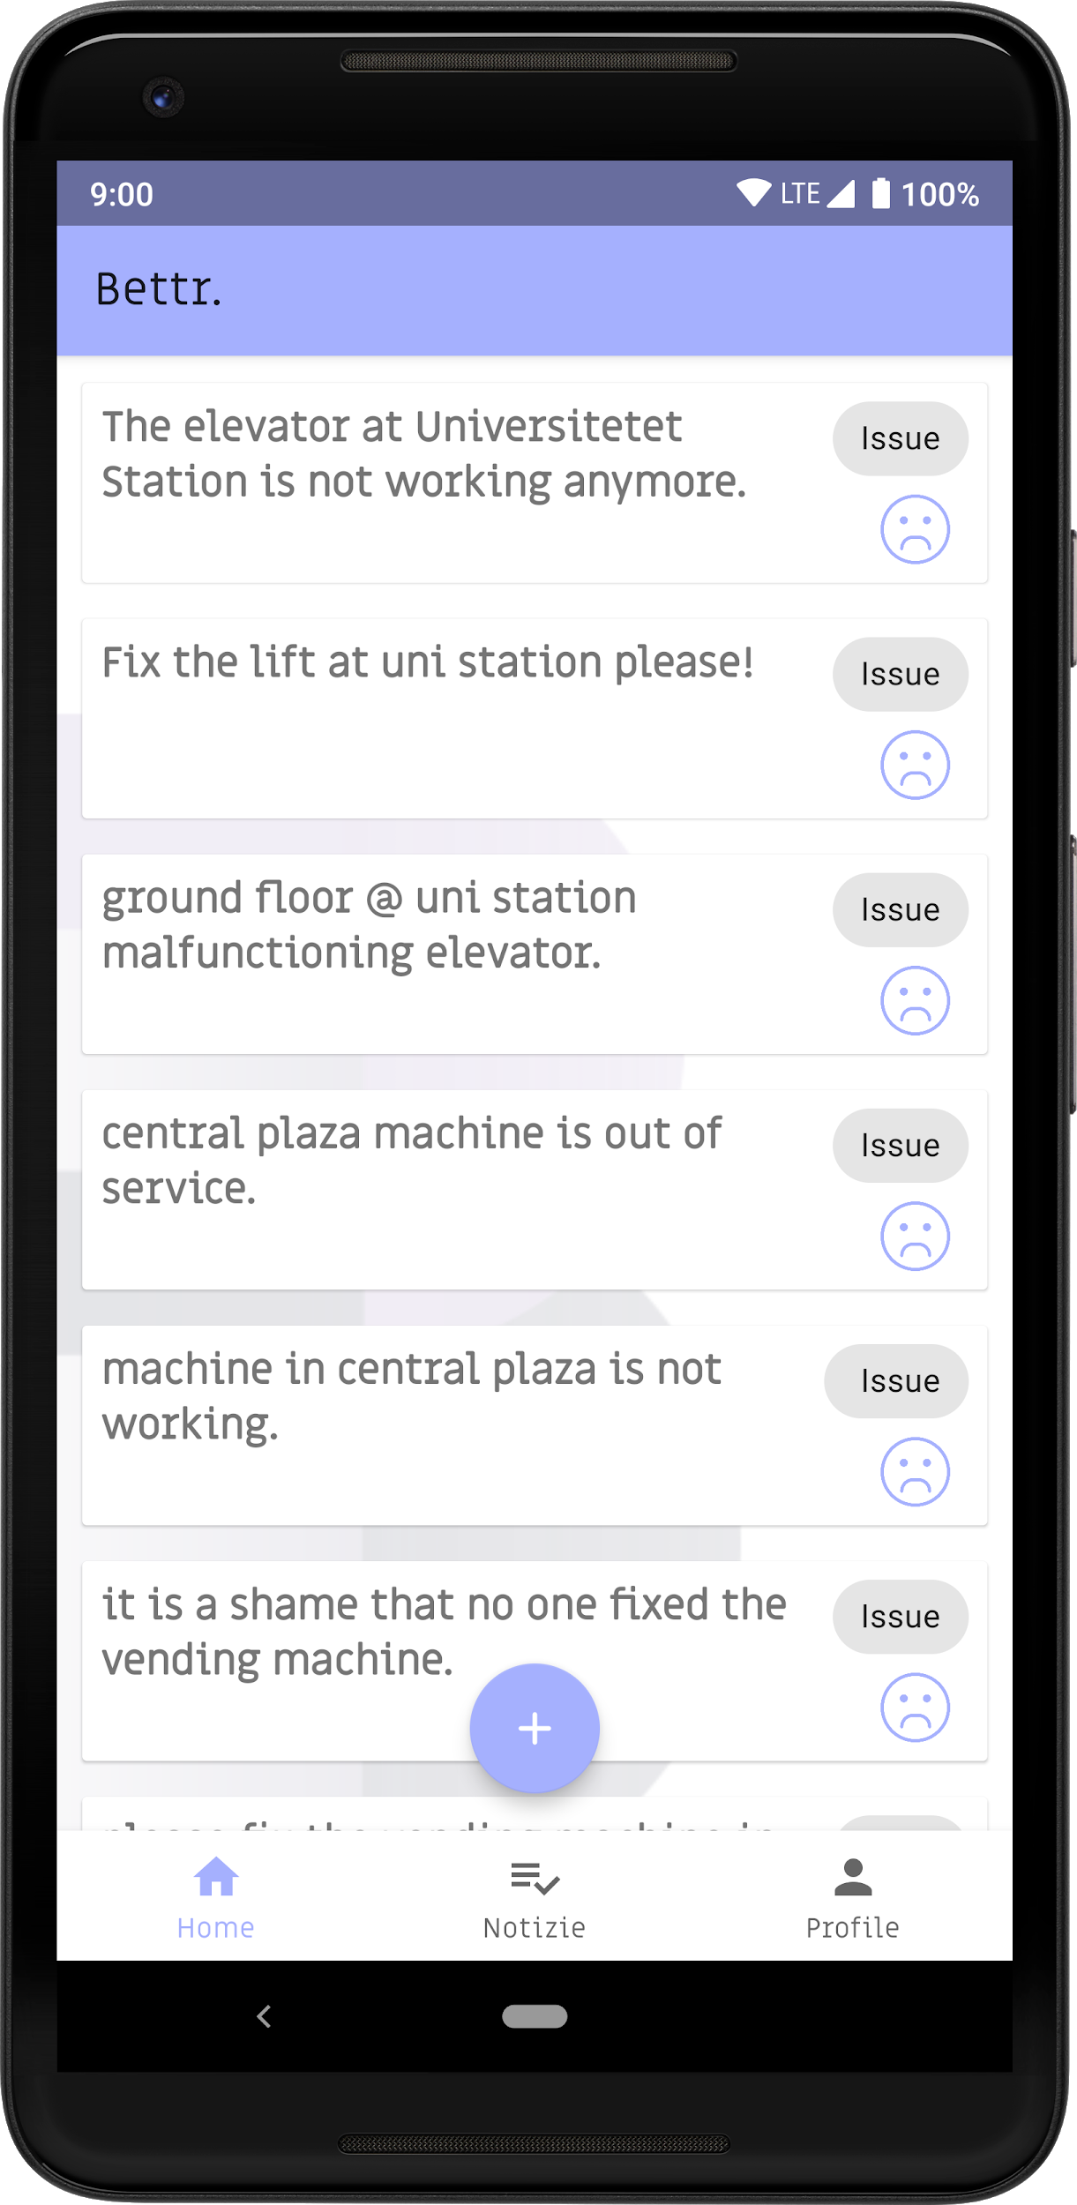
Bettr. for Android
Share opinions, suggestions and issues on the fly.
See how users react to your posts and check back later to see how many users approve it.
Place your screenshot here

Slide 20
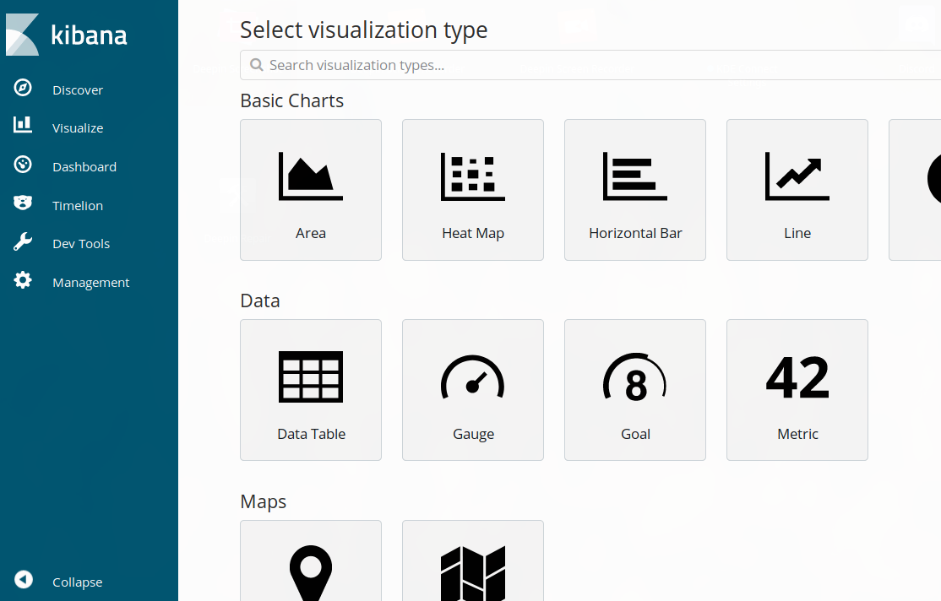
Data Visualization
Data can be visualized by choosing different metrics. Heatmaps, Region maps and more can be generated on the fly thanks to the Kibana-based dashboard.

Slide 21

THANKS!
Any questions?

Slide 22
CREDITS
Special thanks to all the people who contributed to this awesome project:
Steepo (Stefano Eportentosi)
JackFrost67 (Fabio D’Elia)
Buggy97 (Farjad Ali)
Davydh (Davide Cazzetta)
MazzuPat (Patrick Mazzucchetti)
NTAuthority (Ayoub Chouak)

